Slide 1







Interfaces, Models, and Monitoring for Resource-aware Transformations that Augment the Lifecycle of Systems (IMMoRTALS)
BBN Site Visit

Slide 2
Agenda
Program Review: 30 minutes
technical approach, overall system architecture, goals, schedule, milestones, etc.
R&D Spotlight: 30 minutes (15 + 15)
1-2 interesting research problems and/or key technical issues currently being worked on
Phase 1 platform demonstration workshop: 15 minutes
Technical and programmatic plans/preparations
MIT-LL Interaction: 15 minutes
Impression w.r.t. challenge problems, evaluation, etc.
Looking ahead to Phase II: 15 minutes
CPs, Tech milestones)
Demo (s): 30 minutes
Tech transition: 15 minutes
Usability: 15 minutes
Conclusion, action items/break for lunch: 15 minutes

Slide 3
Program Review

Slide 4
Outline
Programmatics
Summary of progress
Goals (platform, domain)
Key concepts and assumptions
Approach
System overview
Phase 1 CPs

Slide 5
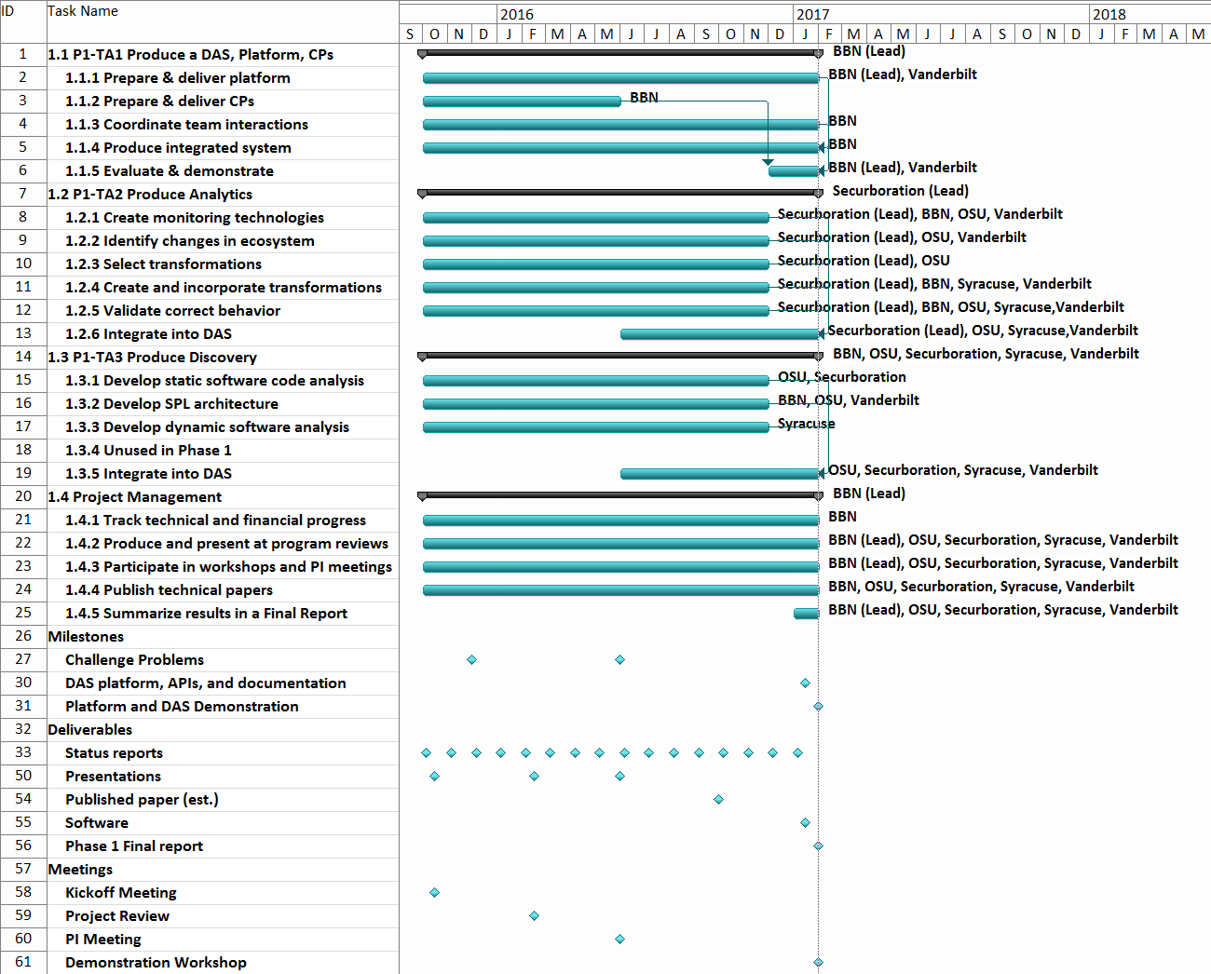
Programmatics
We are here

Slide 6
Program Status/Summary of Progress
Platform Instantiation
Challenge Problem Definition
Reasonably complete
Vocabulary/Ontology
Environment Model
Ongoing work, initial capabilities developed
Program Analysis
Resource DSL
DAS
CP in DAS
Adaptation/CP Enhancements
Recently Started
Apr Site Visit End to end Demo
We are here
Publications:
3 accepted
6 submitted
TB Updated
Notes:
Note for the speaker: Stood up the platform, published the two CPs, have a vocabulary to represent the functional and extrafunctional aspects of the program and the ecosystem, have initial capabilities for program analysis to discover resource dependency and usage, DSL for checking, working DAS v1– not pretty looking or with nice interfaces– in process of integrated the upgrades of the components, CP1 working in the DAS v1, CP2 is in process, and also already started looking an enhancements to CPs that will stretch the limits of current analysis and synthesis capabilities. And started publishing..
List of publications

Slide 7
Summary of Progress
TBD

Slide 8
IMMoRTALS Goals and CONOPS
IMMoRTALS Platform
Marti + ATAK light clients for sharing SA information
IMMoRTALS Domain
SA Data (location, images, short text annotations)
Sharing– sending, receiving, storing
Adapt the baseline to varying missions
Changes in functional requirements
Changes in available resources in the target environment

Slide 9

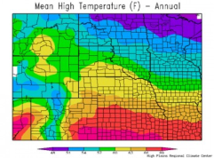
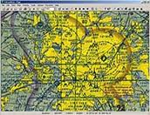
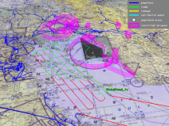
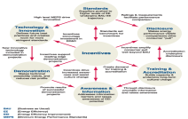
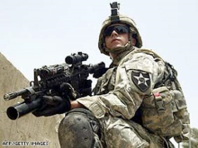
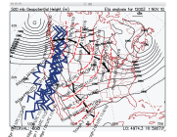
Dimensions of Mission-Specific Tactical Situation Awareness*
Climate
Visibility, rain, wind
Temperature
Current & future
Mission
ISR
Search and Rescue
Supply
Policy
Organization policies
Operating procedures
Rules of engagement
Mission plans
Location
Geo coordinates
Terrain/buildings (images)
Surrounding
No contact, taking fire
Red/blue forces
Risk Estimated Distance
Location is Central to Tactical SA
Equipment
Battery & load
Fuel
Ammunition
Movement
Tracks
Planned/observed routes
Velocity
*Adapted from Cognitive Radio Architecture Evolution, Mitola, IEEE, 2009
By focusing on Location first, IMMoRTALS is addressing a tactical SA functionality that is
likely to cause or encounter significant changes over the life of the SA application
Notes:
Some of the dimensions that the warfighter considers when they build their own mission specific operational picture.

Slide 10
Two Flavors of Program Adaptation in IMMoRTALS
Baseline
New mission
requirement
New target
environment
Library Update
HW Update
time
Offline, pre-deployment adaptation
…
In response to changes, the baseline application evolves – resulting in program variants that have different source code and binary. This adaptation happens offline, i.e., the new binary needs to be deployed to take advantage of the adaptation. The changes in code include substitution, addition, removal of code elements.
Changes in the
operating
environment
Online, runtime adaptation
Or
Or
behavior
instrumentation
In response to changes, the deployed application adapts its behavior or adapts its binary to preserve the behavior or adapts both its binary and behavior – the deployed binary is modified (may involve downloading patches). This adaptation happens online, i.e., when the application is used in mission, no new variant with different source or binary is generated. Needs additional instrumentation to be present in the deployed binary (the black oval )

Slide 11
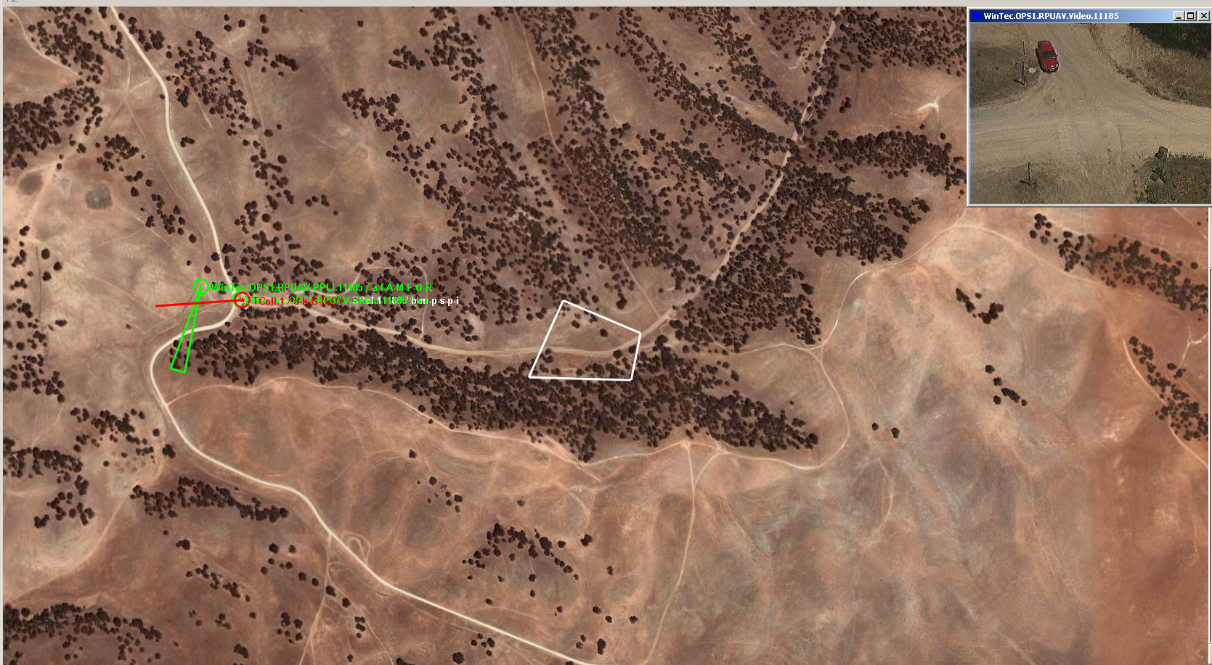


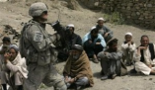

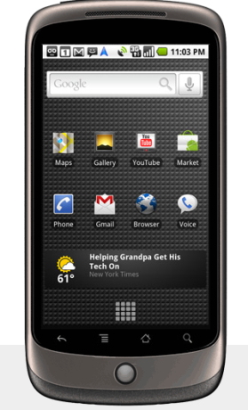
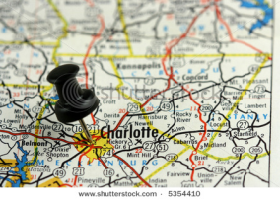
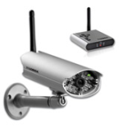
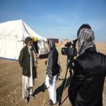
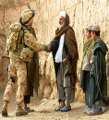
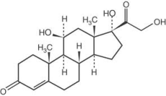

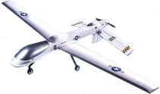
Example Mission, Supporting Data Sources, & Hardware/Software Assets
Mission: Extract NGO aid workers who are being threatened by insurgents in a village.
Historical Databases
Tasks in Achieving Mission Goals
Data Sources & Assets
Identify friends & relevant info (e.g., visual id, languages)
Understand prior interactions with friends & leaders
Locate/track friends, enemies, & victims
Find layouts of streets, landmarks
Identify potentially “safe” & “unsafe” locations
Annotated text,
pictures, video
geo-location data
Plan safe, alternative, & escape routes
UAV video feed, sensor information, handsets, location data
Communicate with nearby units, base stations
Reachback to command centers, support (air/naval)

Slide 12
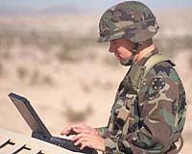
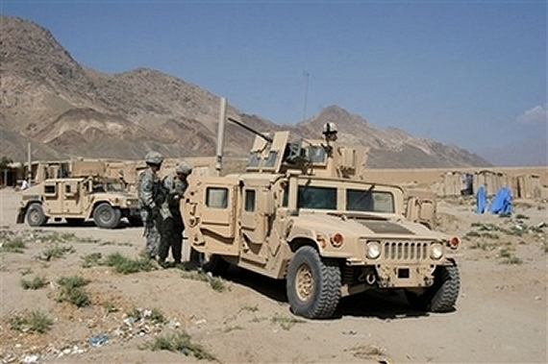
Example Mission, Supporting Data Sources, & Hardware/Software Assets
Mission: Extract NGO aid workers who are being threatened by insurgents in a village.
Historical Databases
Tasks in Achieving Mission Goals
Data Sources & Assets
Identify friends & relevant info (e.g., visual id, languages)
Understand prior interactions with friends & leaders
Locate/track friends, enemies, & victims
Find layouts of streets, landmarks
Identify potentially “safe” & “unsafe” locations
Annotated text,
pictures, video
geo-location data
Plan safe, alternative & escape routes
UAV video feed, sensor information, handsets, location data
Current SA application works with handhelds coordinated with a server over IP and assumes unobstructed GPS
Communicate with nearby units, base stations
Task 1
Task 2
Problem: what if the mission is set in a canopied jungle, or the adversary has the ability to spoof GPS
Problem: what if the mission is set in a network challenged environment, and has a large number of participants?

Slide 13
Key Concepts and Assumptions
Concepts
Granularity– DFUs //explain without wrapping ourselves in a death spiral//
RDF knowledge repo
Basic mutation operations: replace, add, delete
Offline adaptation (source code evolution) and online adaptation (bytecode rewriting)
Assumptions
What is give to us – functional spec,
What are we deriving/inferring– extra-functional (dependency, usage)
Control Points– simplifying assumption– indicating which parts of the code are adaptable– not every line of code is //explain without wrapping ourselves in a death spiral//
Others, if any

Slide 14




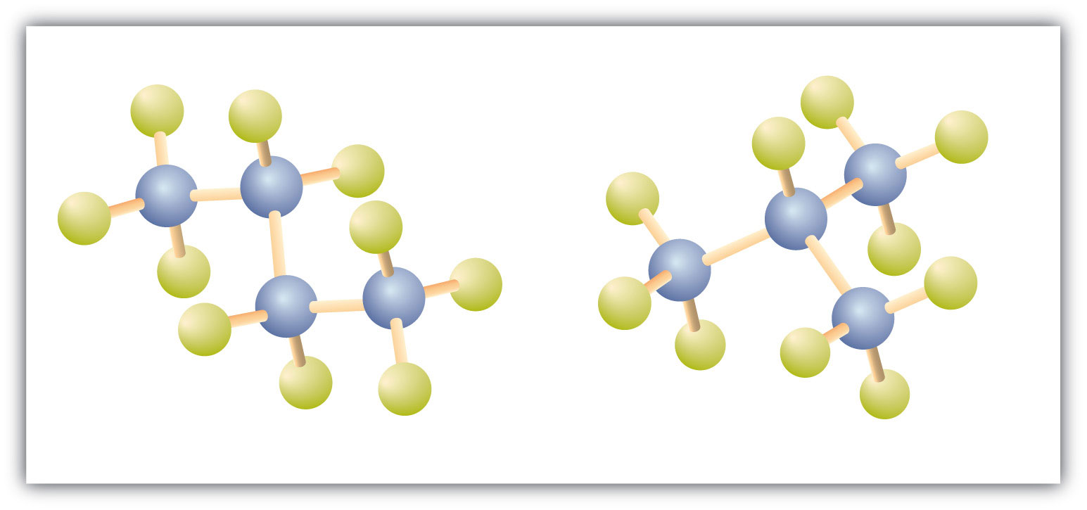
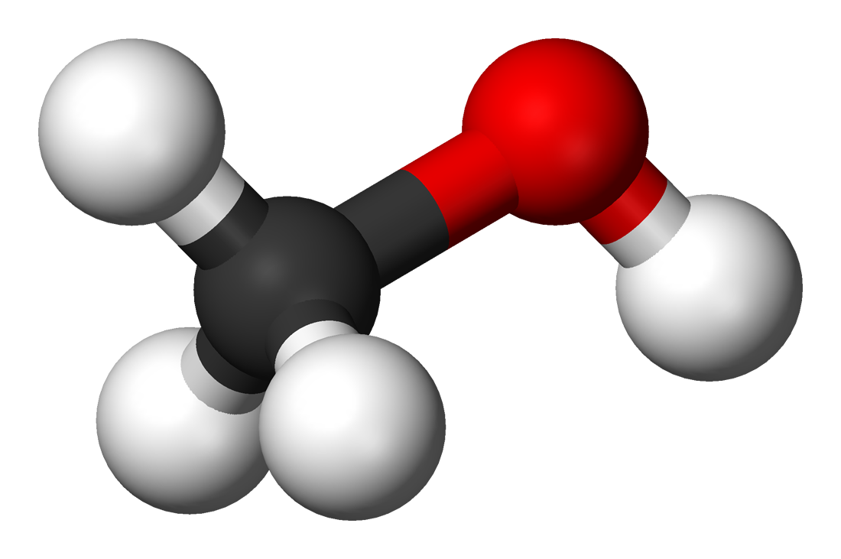




Approach: Deriving Adaptation
Deriving adaptation involves reasoning about the software and the adaptation trigger
Adaptation trigger could be a “change request” or an “observed or detected change”
Usually, observed/detected changes → runtime
Changes observed at runtime may result in offline (outside of the executing mission) adaptation (e.g., modifying source code to create new binary)
Of course, requests to support new deployment environment or modified functionality are offline change drivers
Reasoning takes place in “model space” – i.e., in terms of abstract representation of code, resources, their relationships
DAS workflow uses
SPARQL queries over Triple store: identify candidates for adaptation
Resource DSL (refinement and variational types): quickly evaluate combinatorial space of adapted systems
Essentially, algorithmic use of the combined power of SPARQL and Type system
Change request
Reasoning and Analysis
Detected changes
DAS machinery
models
Source code
Code massaging
Adapted code

Slide 15
Approach: Deriving Adaptation (contd)
What is in the model space:
Domain knowledge
Currently, simple/high level/global/axiomatic rules e.g.,
if resource R is contested, reduce consumption of R
May need domain-specific (i.e., tactical SA) specific refinements or concretizations e.g.,
Bandwidth consumption depends on size of SA messages being sent
Sufficient knowledge about functional and extra-functional specification of
The (baseline) application:
Functionality: Definition, Use, Usage Pattern
Extra functional: Resource dependency, Resource usage
Ingredients/raw material for adaptation- code that transforms domain specific data types, domain specific functions: similar functional and extra functional description
Simplifying assumption: not every line of the baseline is adaptable – we are demonstrating the technology with a specified subset (control points)
End to end flow
See next page
Reasoning
Guided search with constraint satisfaction, type checking, and type selection
Declaration of X*
Definition of artifact X
DFU
Control Point1
Other uses of X
Definition of artifact X
Control Point2
Other uses of X and Y
DFU
Declaration of Y*
Currently Java objects, so definitions are classes
DFU s could generalize to artifacts other than classes
Application Code
For control points, the intended use of the objects, and the functional and extra functional specification of the code implementing them are available
Note:
functional→ given,
extra-functional→ discovered

Slide 16
IMMoRTALS System Overview
IMMoRTALS code base, build and test environment
Error report, deploy/update SW
IMMoRTALS Management Network
Host
Ecosystem
SA producer & consumer
Brokering and Storage
IMMoRTALS back end
Operational Network
Server Host
Android
Ecosystem
Ecosystem
Android Clients
Linux/Java Server
Backend
Deployed/running platform application
Change detection tools
Runtime management tools
Program synthesis tools
Build tools
Validation tools
Program analysis tools
Repo
y

Slide 17
Phase 1 CPs
Driven by changes in functional (e.g., mission requirement) and extra functional (e.g., resources) requirements and constraints
Evaluation is focused on correctness (i.e., it is mostly verification)—no qualitative distinction is made among the possible solutions
Verification is through tests to show that functional intent is preserved
Realized by substitution of components that follow the same usage pattern as baseline
Substitute(s) that could work exists; choose & message the code
Compose a substitute from available components, and then message the code

Slide 18
Mapping Sample Mission into Phase 1 Challenge Problems
Challenge problem 1is focused on Location/Location Provider
Variations in environment:
Desert: GPS is available
Jungle under canopy: GPS unavailable (leaves block radio signals)
Indoors: GPS unavailable
Variations in mission requirements:
Any location where adversarial GPS-spoofing is expected: trusted GPS required
Challenge problem 2 is focused on contested resource (such as network bandwidth in our current version)
Number of clients
Network capacity (various mesh networks vs. cellular 3G vs. 4G)

Slide 19





Task 1: Offline adaptation in response to mission requirement changes
Problem 1: New mission requires location information that can be trusted. Baseline application uses a location provider that is commercial grade. Components that provide more accurate and authenticated location information can be found. How to adapt the baseline code to work with trusted location provider?
: Commercial Grade
: Accuracy <Low>
: Untrusted
Change request:
Mission needs
Accurate and
trusted location
: Military Grade
: Accuracy <High>
: Trusted
: Commercial Grade
: Accuracy <High>
Rest of the Program
Location Provider
Available components (analyzed, modeled)
Current application
Shapes do not imply exact signature match: some code massaging may still be needed to compile and run
Notes:
What is the right user interface that can support this capability?
During what phases of the mission can these capabilities be used?
How do we evaluate the usability of this capability?

Slide 20


Task 1: Substitute and Massage the Code
Solution: Represent relevant semantics of the location providers and the use of location provider in the application. Infer resource dependency and resource usage of location providers and augment the models. Identify candidate location providers that offer the desired properties. Substitute the existing location provider, managing any differences in signature (the function names and argument order may be different) and functional dependencies (initialization, imports etc). Evaluate resource usage, build and test.
Rest of the Program
Mutated application
Location Provider
Filter by “friends”
Filter by Location
Available components (analyzed, modeled)
Notes:
Warfighter & Mission Context
who
what
when
why

Slide 21
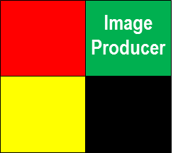
Task 2: Offline adaptation to mission requirement and target environment change
Problem 2: New mission is in a bandwidth restricted environment. The new mission handles the same SA data as the baseline (images), but has a different number of clients publishing at a different rate from the baseline (which was 1 publisher and 1 subscriber). How to adapt the baseline so that the new variant provides acceptable performance?
Bandwidth footprint
Change request:
Message frequency
Available bandwidth
Image Producer
Image transformers
Current application
Other image producers
Notes:
What is the right user interface that can support this capability?
During what phases of the mission can these capabilities be used?
How do we evaluate the usability of this capability?

Slide 22
Task 2: Synthesize and add code that relieves the pressure on bandwidth
Solution: As before, semantic and resource specification is in the model space. Resource DSL type checking reveals that with the mission parameters (num. clients, publication size and frequency), the bandwidth requirement will exceed what is available. Further analyses of the models reveal:
The function that sends SA data uses bandwidth and amount of data put on the network is correlated to the SA data being sent
Code exists that compresses objects or transforms images
Compose compression or image transformation with SA data, and massage code to address syntax and functional dependency. Re-evaluate resource usage, build and test as before
: Size of image produced
→
: Scale factor
New bandwidth footprint
Composed Image Producer
Adapted application
: Size of image produced
Use substitution
Notes:
Warfighter & Mission Context
who
what
when
why

Slide 23
R&D Spotlight

Slide 24
Topics
Need to choose two from the list
Tracking transitive resource usage and dependency
we know line X uses network, which DFU is network dependent?
how much network resource is being used
Something in the area of resource types
Formalizing automated program modification/synthesis using 3 mutation primitives
Others??

Slide 25
Phase 1 workshop

Slide 26
Outline
Logistics
Server, VM, Android devices
Emulation (GPS signal, network etc )
Technical
TA4 Interface
Knobs
Validation (baseline 1, baseline 2, DAS adaptation)

Slide 27
LL Interaction

Slide 28
Outline
Issues encountered
IMMoRTALS’s uniqueness
Pre-deployment changes
Mission requirement changes, in addition to resources
Runtime system (Marti+ ATAK light)
Not always a sharp black and white between what will work and will not
Specifics??

Slide 29
Looking ahead at Phase 2

Slide 30
Organizing adaptations into phase-specific CPs
Phase1
Driven by changes in functional and extra functional requirements and constraints
Evaluation is focused on correctness (i.e., it is mostly verification)—no qualitative distinction is made among the possible solutions
Verification is through tests to show that functional intent is preserved
Realized by substitution of components that follow the same usage pattern as baseline
Substitute(s) that could work exists; choose & message the code
Compose a substitute from available components, and then message the code
Phase 2
Driven by changes in 3rd party software (OS, Libraries) or services
Evaluation will consider qualitative differences among possible solutions and the one that the DAS produces
Verification: same as before
Realized by combination of basic mutations on code: substitute, add (i.e., compose), and remove
Still mostly changes in source code to produce new binaries
Will consider composing simple “controller” code enabling simple runtime behavior adaptation
Will extend the supported patterns of usage
Phase3
Focused on handling changes encountered at runtime by runtime adaptation
Evaluation will focus on runtime aspects such as time taken to adapt, amount of disruption, level of degradation etc.
Verification: same as before
Realized by pre-installed instrumentation in the application that responds to observed runtime changes
Will change the behavior of the application by altering the data and control flow
Will modify the application binary (rewriting or downloading bytecodes)
May adapt (update or modify) the initial instrumentation as well

Slide 31
Demo

Slide 32


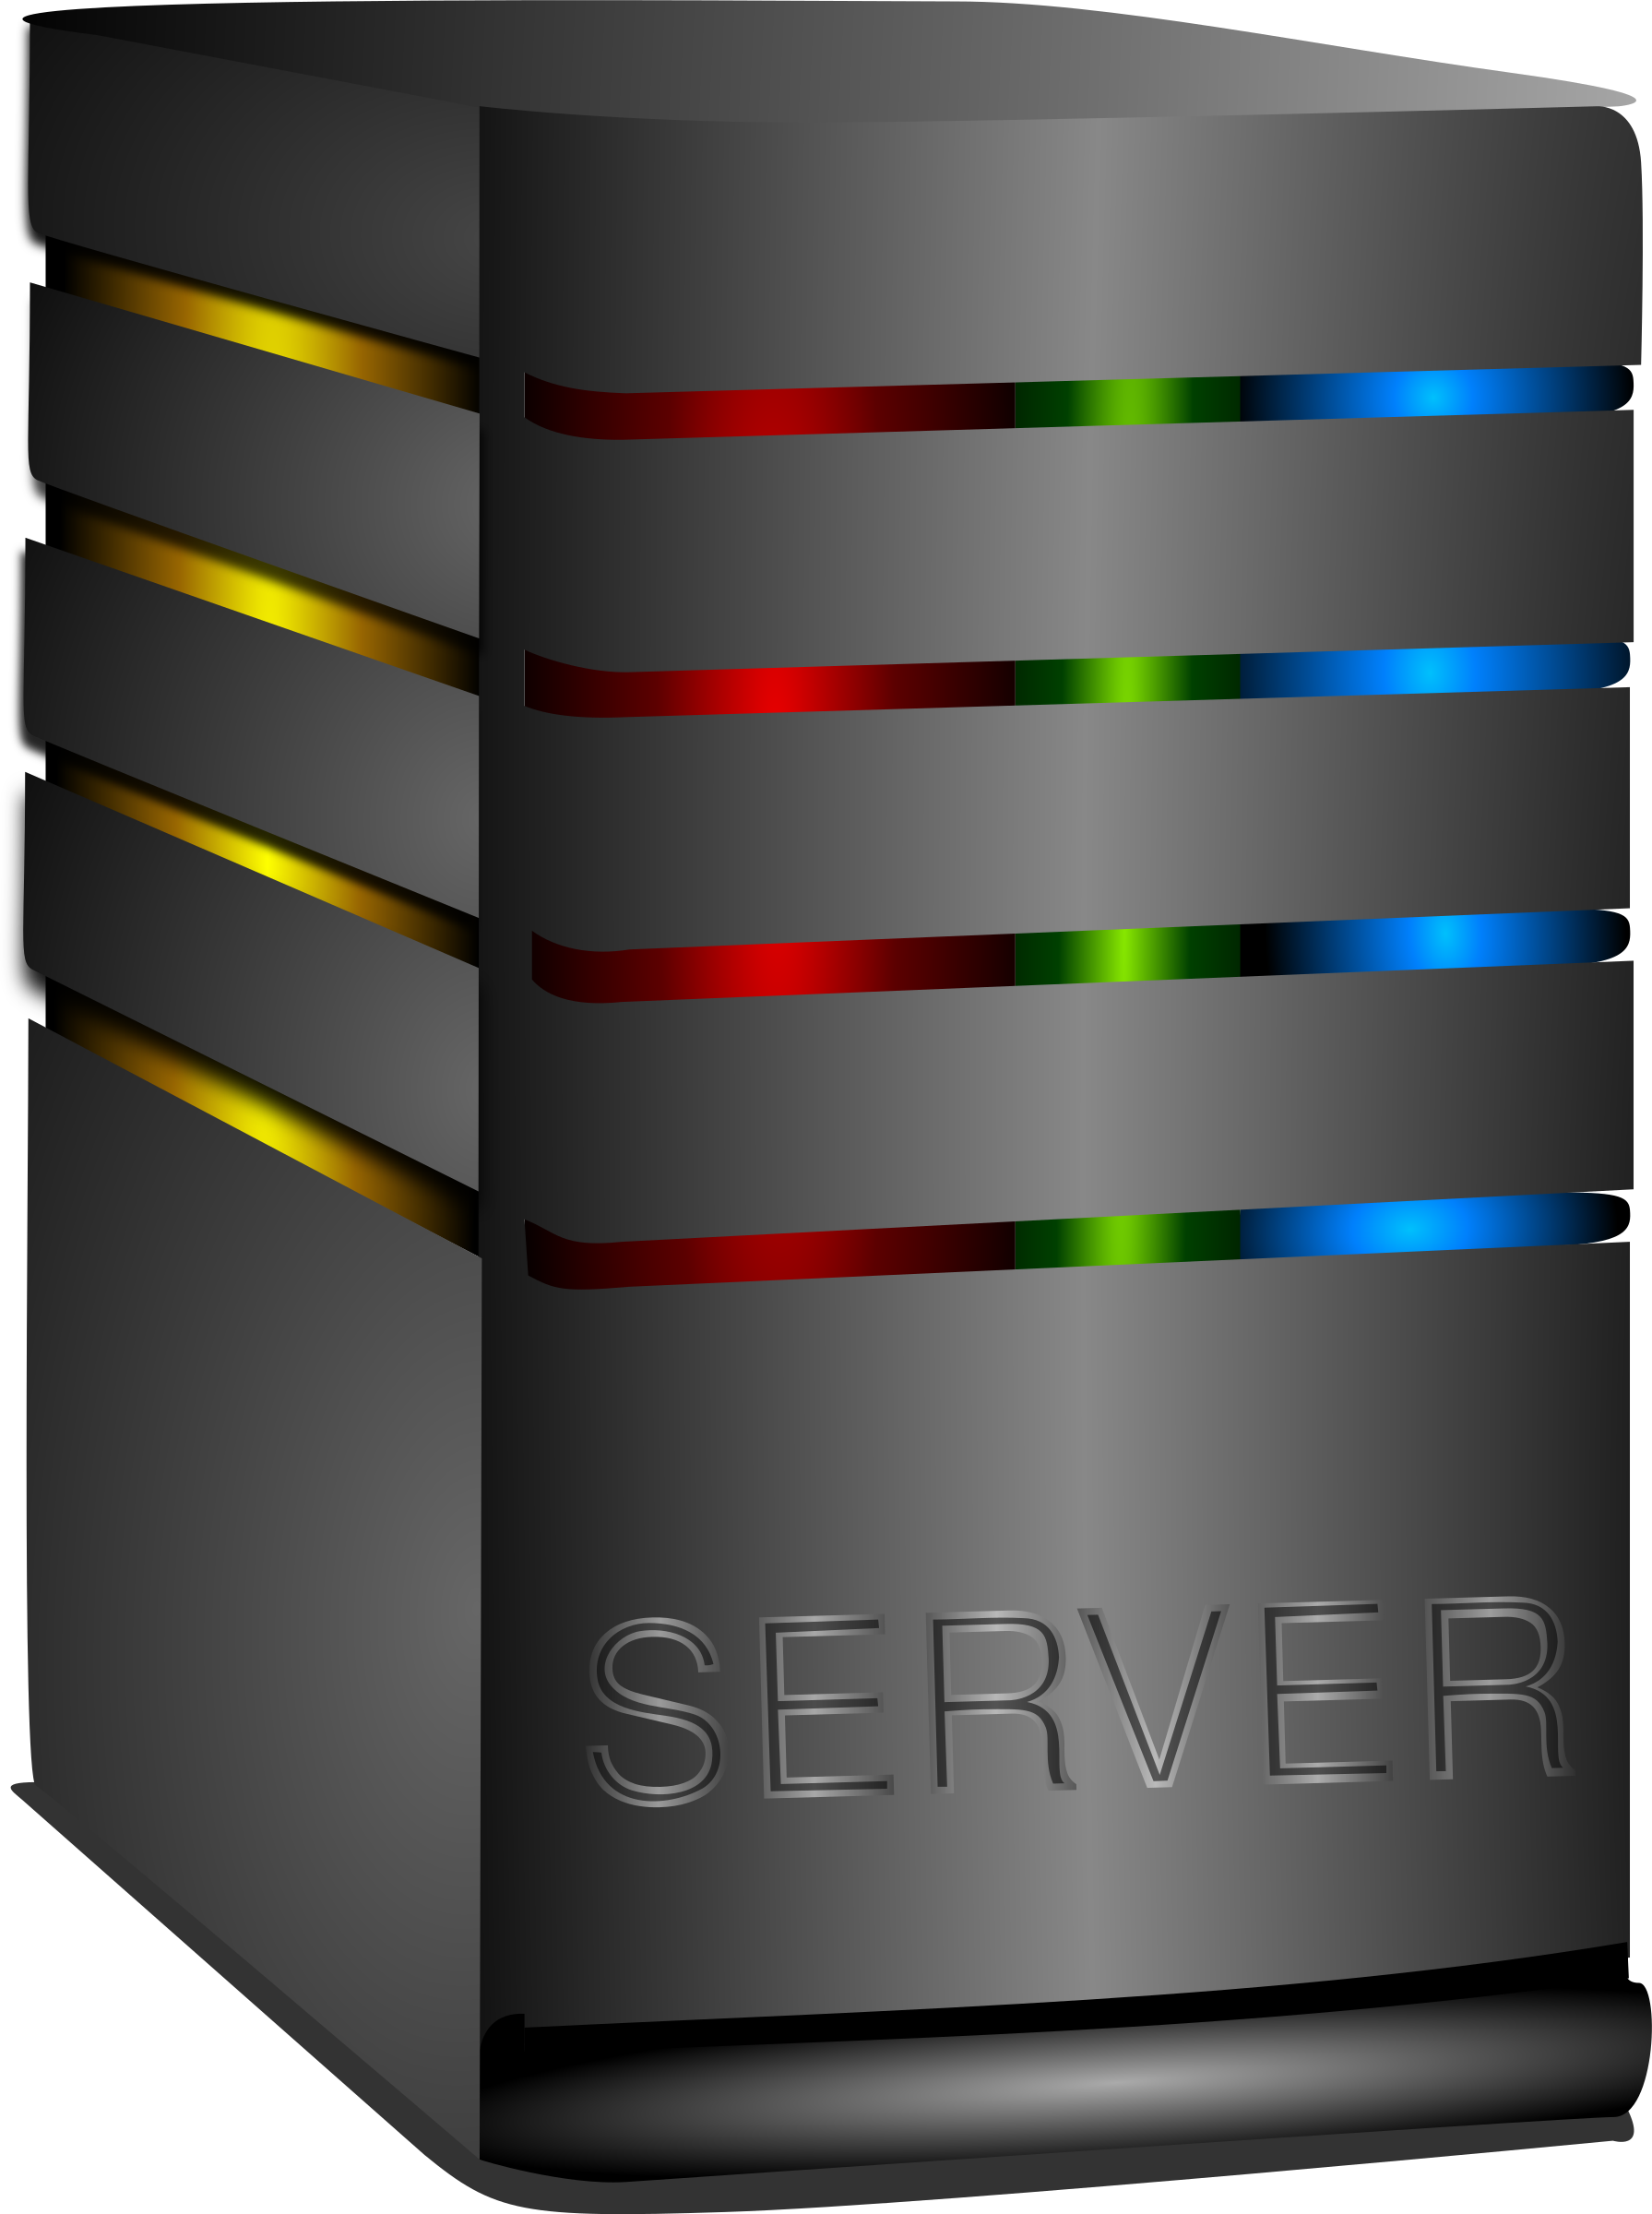


Change Request
Emulated Network
Mission Requirements
Environmental Resources
Mission requirement and resources same as expected by baseline application: deploy and run
Requirement and resources are different: deploy with the new requirement and resource configuration, and run
Run Baseline
Triple Store
Handle Change
Host
Results
Ecosystem
Status Reports
Invoke DAS
IMMoRTALS DAS
TA4 Interface

Slide 33
Tech Transition

Slide 34
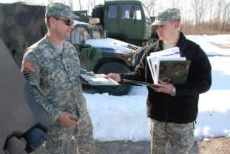
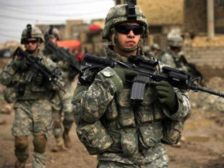

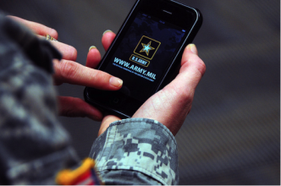
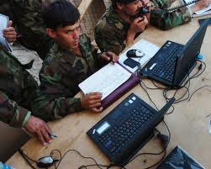
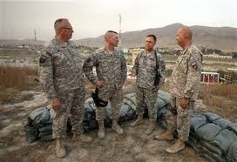
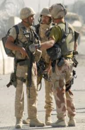

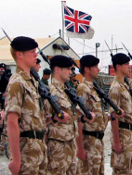
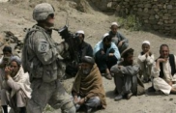
ConOps: “Boots-on-the-ground” – Mission Activities at the Tactical Edge
Mission Planning
Identify Data Sources & Hardware/Software Assets Available
Receive Mission Assignment
Share & filter information as required by mission needs & context
Analyze & report completed mission
Tailor & use mission-specific operational picture
Mission Analysis
Mission Execution
Create, adapt, & share SA capabilities throughout lifecycle at tactical edge
Notes:
Highlevel overview of where our problem fits in the big picture.

Slide 35
ConOps: Motivations for Lifecycle & Resource Adaptation
Mission Planning
Number/diversity of sources, volume of and security classification of data, hardware/software capabilities to choose from are increasing rapidly
Missions are increasingly variable (sanctions, counter-drug, terrorism, insurgency, humanitarian assistance, …)
Warfighters must be able to function despite dynamic changes in mission focus, data sources, network availability, and environmental conditions
Warfighters must be able to analyze solutions & improve them throughout the lifecycle
Warfighters must have confidence to use & share adapted solutions in mission-critical contexts
Mission Analysis
Mission Execution
Mission support applications must adapt reliably and efficiently to
accommodate these dynamic factors and changes
Notes:
Highlevel overview of where our problem fits in the big picture.

Slide 36
Organizing Changes and Adaptive Response to Changes
Changes
Adaptations
Mission Requirements
Number of nodes
Roles of participants
Interoperability
Include/Exclude data
Substitution
Addition
Deployment environment
Hardware
Operating system
Network
Third-party libraries
Removal
Change drivers can affect what is available in the target environment or functionality that the mission
needs; Adaptations can be largely thought of as three basic types of program transformation

Slide 37
TAK Server and ATAK

Slide 38
Usability

Slide 39
How are we making IMMoRTALS usable by its intended users (maintainers of ATAK/TAK Server)
Help with building up the semantic model (by using annotations)
Help with building up the dependency and resource usages (program analysis, automation)
GME– Fred to think more
Managing domain model (Jacob)
What are the issues that are hindering usability
There is still some gap between what humans conceive in terms of the mission requirements and the system
Is there an analog for environment changes

Slide 40
Conclusion, Action Items

